Slide 1
Micro Credit Defaulter Project

Slide 2
Problem Statement
A Microfinance Institution (MFI) is an organization that offers financial services to low-income populations known as Micro Finance Services (MFS). MFS include group loans, agricultural loans, individual business loans and so on.
Microfinance is widely accepted as a poverty-reduction tool, representing $70 billion in outstanding loans and a global outreach of 200 million clients. In this project we must work for a telecom microfinance client who has collaborated with an MFI to provide micro-credit on mobile balances to be paid back in 5 days. The Consumer is believed to be defaulter if he deviates from the path of paying back the loaned amount within the time duration of 5 days. For the loan amount of 5 (in Indonesian Rupiah), payback amount should be 6 (in Indonesian Rupiah), while, for the loan amount of 10 (in Indonesian Rupiah), the payback amount should be 12 (in Indonesian Rupiah).

Slide 3
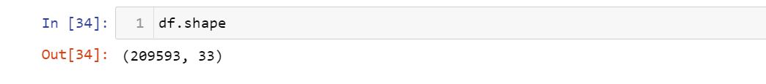
Exploratory Data Analysis
Shape of the data:
This is a big data with 209593 rows and 33 columns.
Null values present:
The dataset has no null values.

Slide 4
1) The dataset had no null values but there were many unrealistic negative values in many features. 2) When we described the data we found that aon,daily_decr30,daily_decr90, rental30,rental90,last_rech_date_ma,last_rech_date_da,medianmarechprebal30,medianmarechprebal90 minimum values are in negative. aon, daily_decr30,daily_decr90 values cannot be negative as age on network can either br 0 or any positive number, age can never be negative. Daily amount spent from main account, averaged over last 30 days (in Indonesian Rupiah) i.e. daily_decr30 can also never be negative as its an amount spent it can either be 0 or positive. Daily amount spent from main account, averaged over last 90 days (in Indonesian Rupiah) i.e. daily_decr90 can also never be negative as its an amount spent it can either be 0 or positive. rental30 and rental 90 being the average account balance over 30 days and 90 days respectively can be considered as negative. Number of days till last recharge of main account i.e. last_rech_date_ma can never be in negative so we would replace negative values by 0. Number of days till last recharge of data i.e. last_rech_date_da can never be in negative so we would replace negative values by 0. medianmarechprebal30 and medianmarechprebal90 can be negative as this is the medium of account balance which could be in negative. 3) Feature Engineering-Initially we had a feature named pdate so to better analyse this feature we splitted pdate into pyear, pmonth and pday. So we found that all the data was of year 2016 so we dropped pdate and pyear column and analysed rest. 4) There was a feature named pcircle, we found out that entire dataset has the same value for pcircle so it seems that all the mobile phone has the same telecom circle. Thus no use of this feature so we droped it as well. 5) There is a feature named msisdn i.e. mobile number of a user which is of object type so we encoded it using ordinal encoder. 6) After creating heatmap as well as after finding vif score of features we found that there was a problem of multicollinearity as many features vif score was greater than 10. So all those features were deleted that caused multicollinearity. 7) Lot many outliers are present in the data set but if we consider deleting them then there will be 21% data loss so deleting outliers is not a good idea. So to overcome this we applied power transformation technique. 8)The applied power transform method will not only deal with outliers but also remove skewness. Due to presence of outliers the data is also skewed a lot. 9)We can observe that data is not at all balanced so we balanced it by resampling and up sampling it. Data was then normally distributed using standardisation technique.

Slide 5
Analysing relationship between features

Slide 6
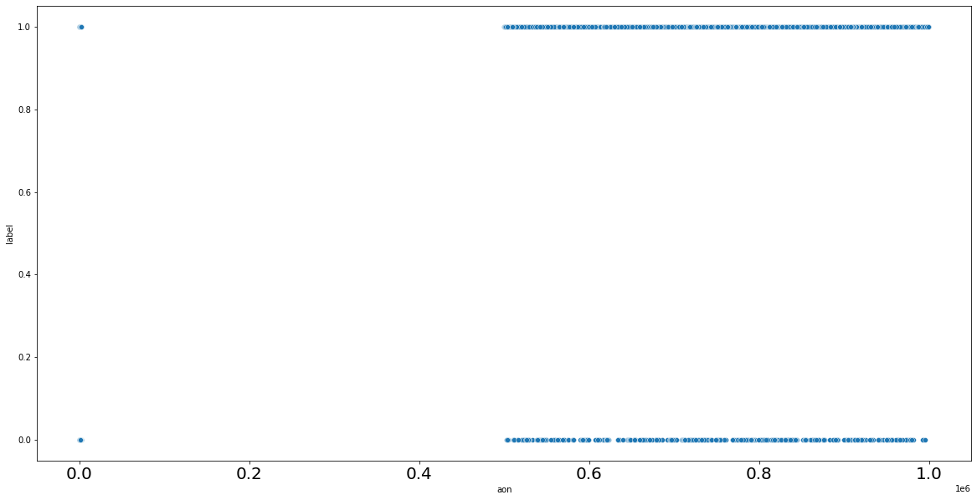
Here we can see that whether a customer is defaulter or not doesn’t depend on age on network (aon)

Slide 7
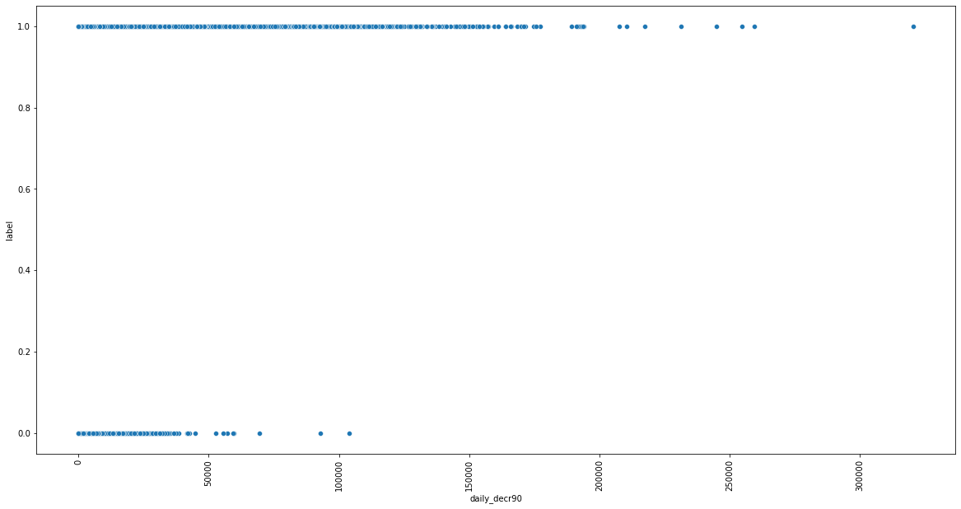
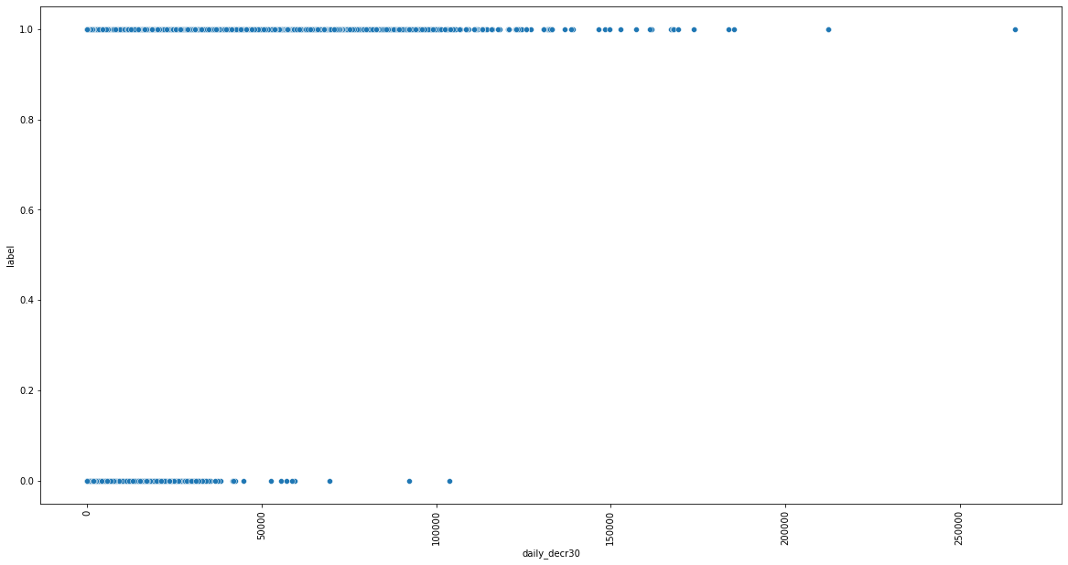
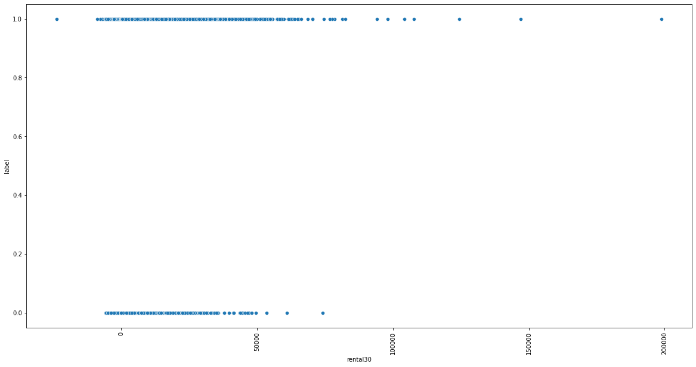
We can see that defaulters average daily amount spend from main account is much higher than the non-defaulters averaged over 30 days and averaged over 90 days.

Slide 8
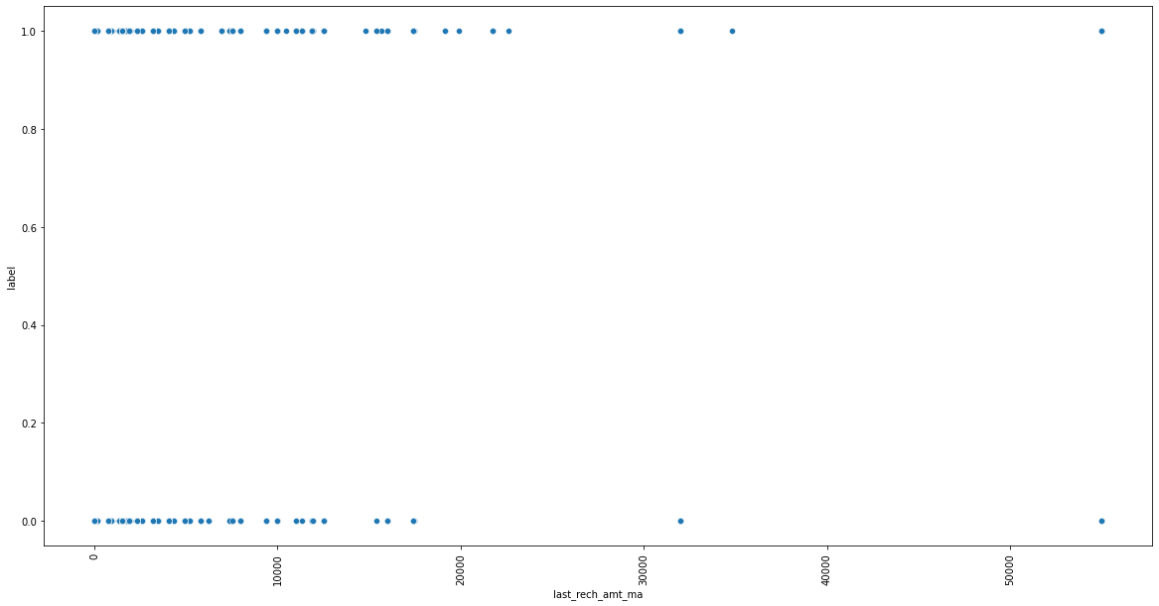
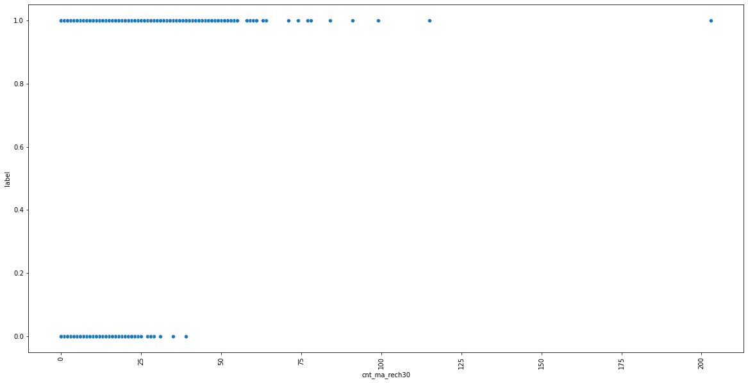
Average main account balance over last 30 days and over last 90 days is higher for defaulters than non-defaulters.

Slide 9
Defaulters get there main account recharge more number of times than non-defaulters.

Slide 10
Defaulters get there main account recharge more number of times than non-defaulters.

Slide 11
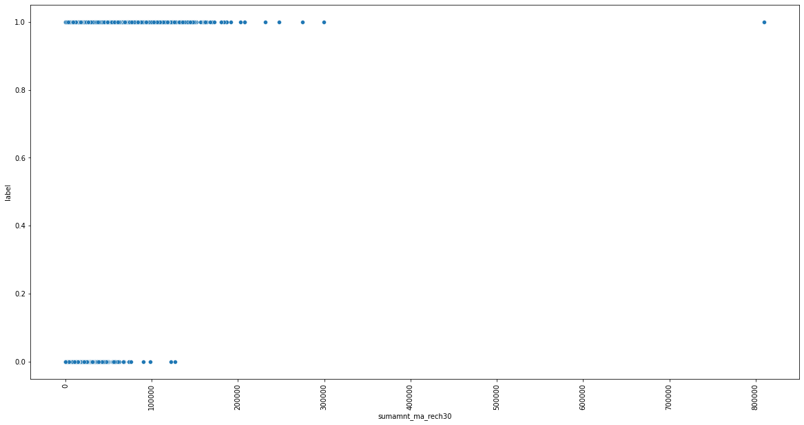
Total amount of recharge in last 30 days is much higher for defaulters than non defaulters.

Slide 12
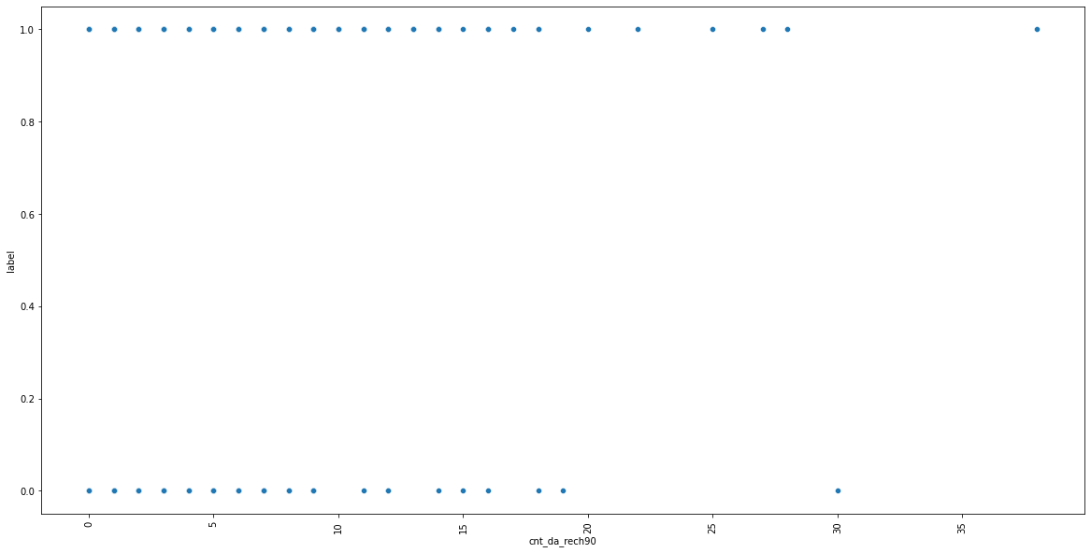
Defaulters recharge there data more number of times in 90 days than non defaulters.

Slide 13
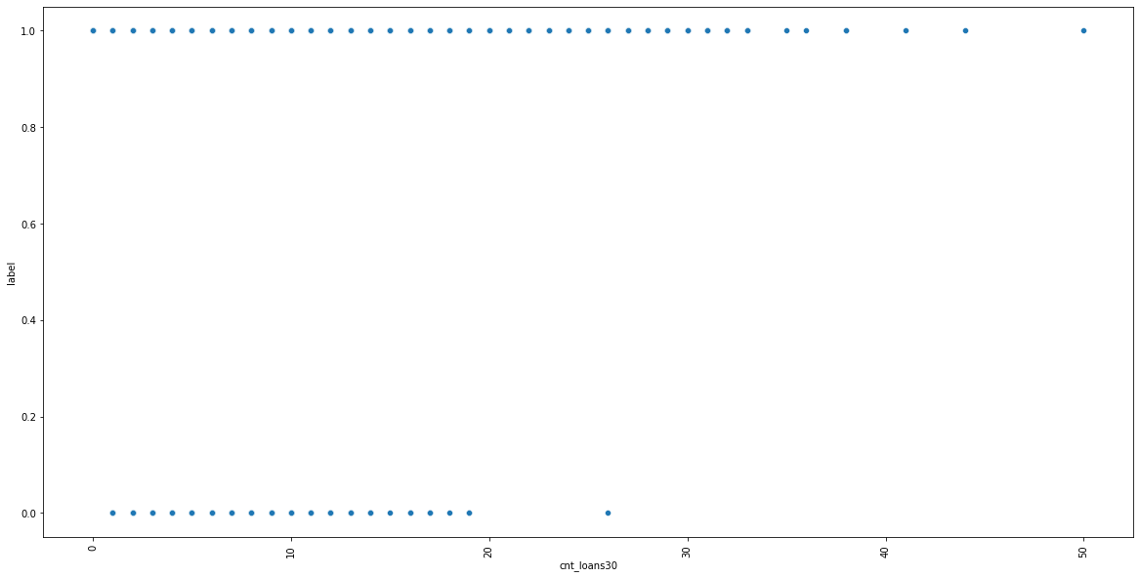
Defaulters take more number of times loan than non defaulters.

Slide 14
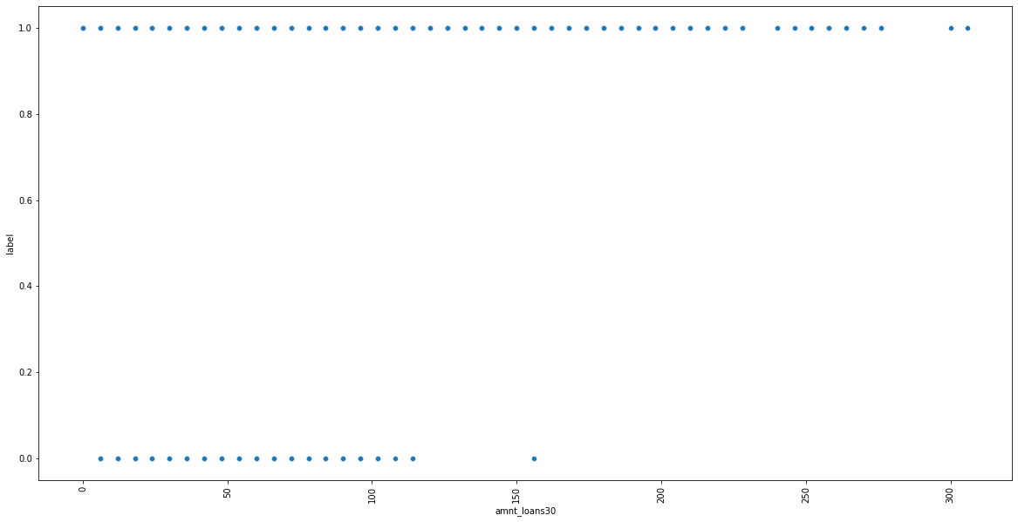
The maximum loan amount taken in last 30 days is higher for defaulters than non defaulter.

Slide 15
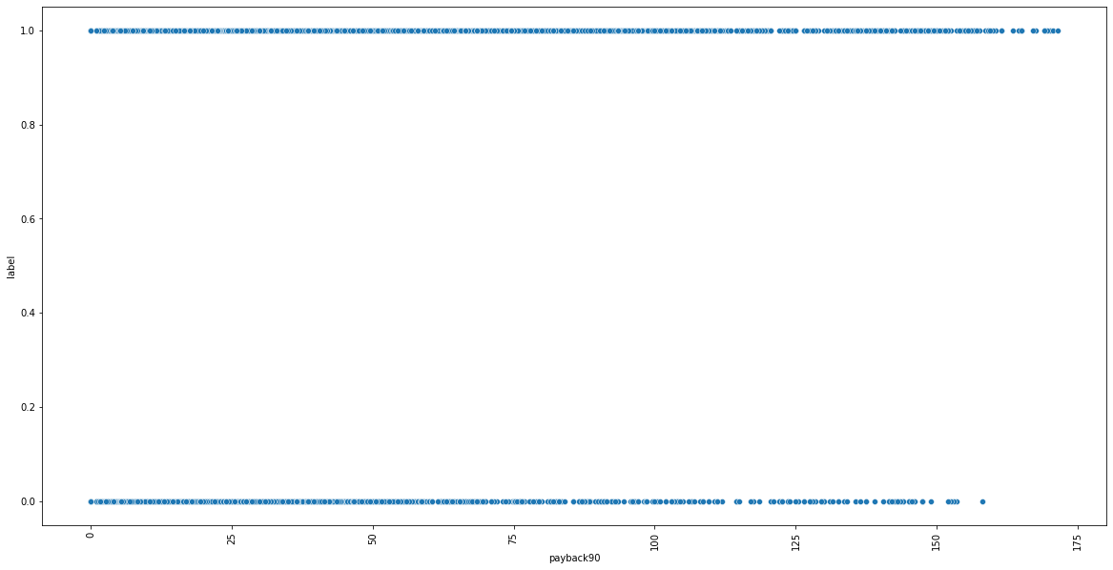
Loan taken in last 30 days and loan taken in last 90 days, the average days of payback for non-defaulters is mostly within 150 days and for defaulters is 175 days.

Slide 16
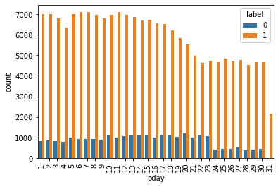
We assume that pday means payment date so we can see from the above graph that customers whose payment date is in the starting of the month are the defaulters.

Slide 17
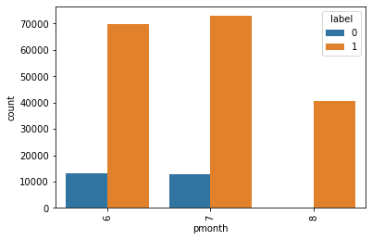
This dataset contains information for three months only. If a customer takes a loan in the month of august then there is highest probability of being a defaulter.

Slide 18
Hardware and Software Requirements and Tools Used
We imported following packages:
import pandas as pd
import numpy as np
import matplotlib.pyplot as plt
import seaborn as sns
from sklearn.preprocessing import OrdinalEncoder
from sklearn.preprocessing import LabelEncoder
from statsmodels.stats.outliers_influence import variance_inflation_factor
from scipy.stats import zscore,boxcox
from sklearn.model_selection import GridSearchCV
from sklearn.preprocessing import StandardScaler
from sklearn.preprocessing import power_transform
from sklearn.model_selection import train_test_split
from sklearn.model_selection import cross_val_score
from sklearn import metrics
from sklearn.metrics import roc_curve,auc,classification_report,accuracy_score
We also installed XGBoost Classifier.

Slide 19
Run and Evaluate selected models

Slide 20
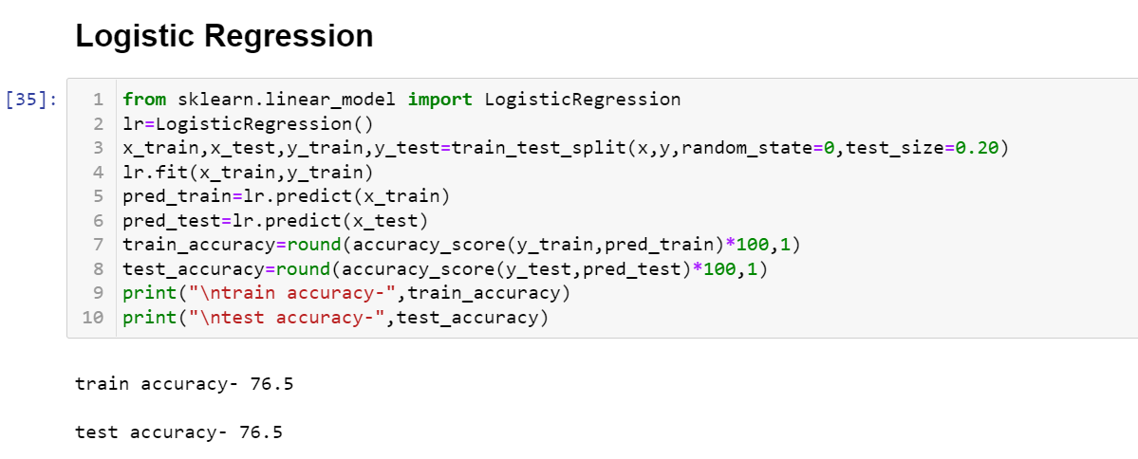
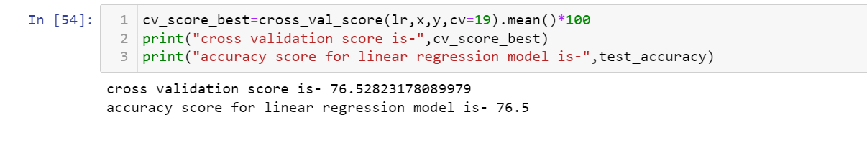
Logistic Regression
We applied this algorithm and found the train accuracy to be 76.5% and test accuracy to be 76.5%.
The test accuracy for logistic regression is 76.5% and its cv score is 76.5% thus making us sure that the model is not overfitted.

Slide 21
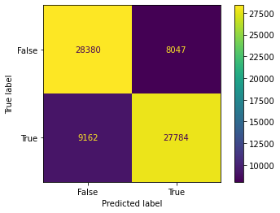
Confusion matrix:
Model is good in predicting false classes but bad in predicting true as well as false classes. Although we can also see that the
samples for true classes and samples for false classes are also equal.

Slide 22
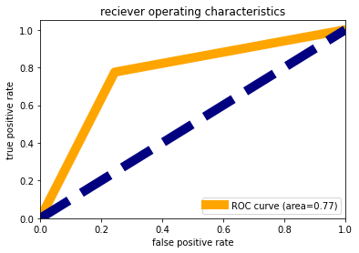
AUC-ROC Curve
We observed that the area under the curve is 77% that means 77% times model is predicting accurately and rest all
other time it gives wrong prediction.

Slide 23
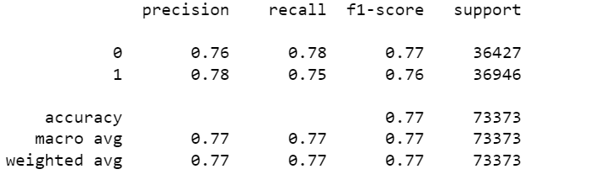
Classification Report
Model is poor in recalling class 1 i.e., True than class 0 i.e. False. F1-score of class 0 is higher than that of class 1.

Slide 24
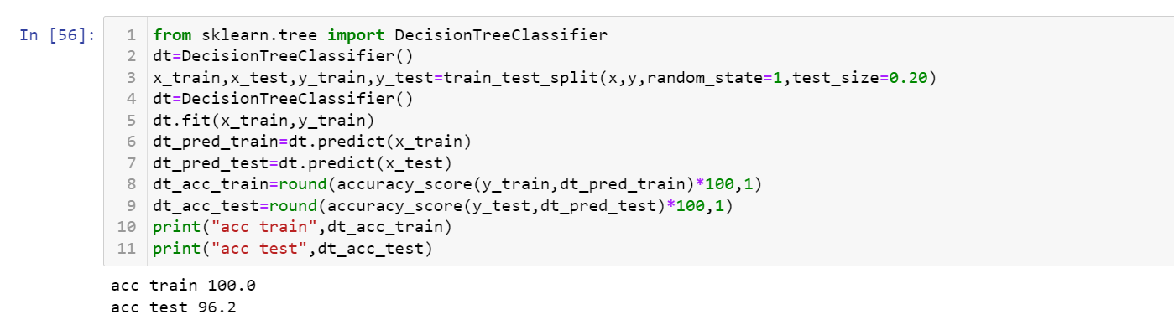
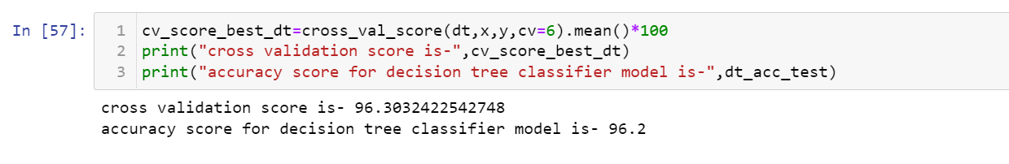
Decision Tree Classifier
We applied this algorithm and found the train accuracy to be 100% and test accuracy to be 96.2%.
The test accuracy for logistic regression is 96.2% and its cv score is 96.3% thus making us sure that the model is not overfitted,
although decision tree classifier is prone to overfitting.

Slide 25
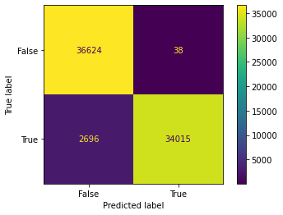
Confusion matrix:
Model is good in predicting false classes but bad in predicting true as well as false classes. Although we can also see that
the samples for true classes and samples for false classes are also equal.

Slide 26
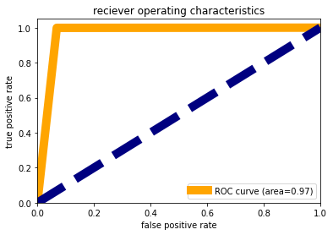
AUC-ROC Curve:
We observed that the area under the curve is 97% that means 97% times model is predicting accurately and rest all other
time it gives wrong prediction. This accuracy is a good one lets check on other metrics as well.

Slide 27
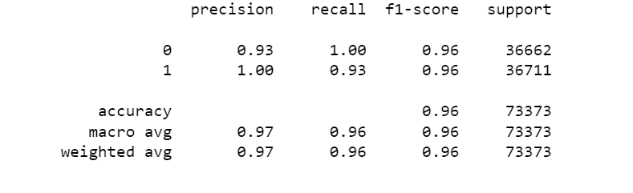
Classification Report:
Model is poor in recalling class 1 i.e., True than class 0 i.e. False, although precision for class 1 is higher than class 0.
F1-score of class 0 is similar to that of class 1.

Slide 28
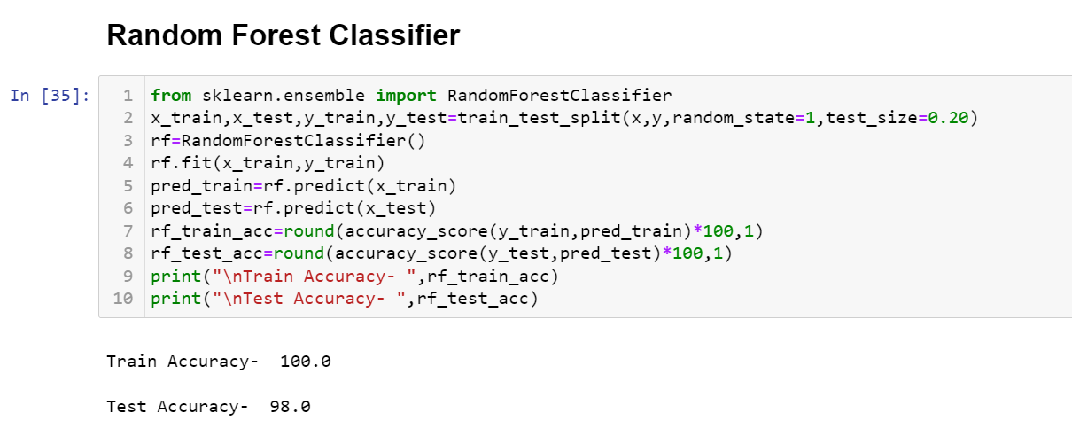
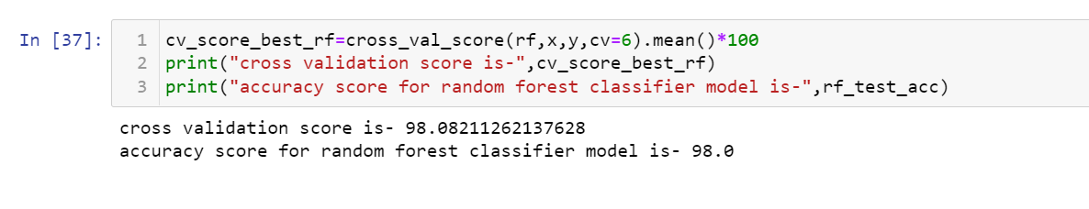
Random Forest Classifier
We applied this algorithm and found the train accuracy to be 100% and test accuracy to be 98%.
The test accuracy for logistic regression is 98% and its cv score is 98% thus making us sure that the model is not overfitted,
although decision tree classifier is prone to overfitting.

Slide 29
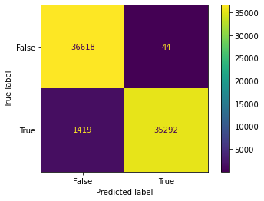
Confusion matrix:
Model is good in predicting false classes but bad in predicting true as well as false classes. Although we can also see that the
samples for true classes and samples for false classes are also equal.

Slide 30
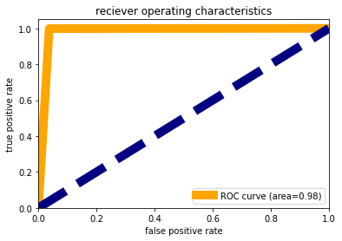
AUC-ROC Curve:
We observed that the area under the curve is 98% that means 98% times model is predicting accurately and rest all other time
it gives wrong prediction. This accuracy is a good one let’s check on other metrics as well.

Slide 31
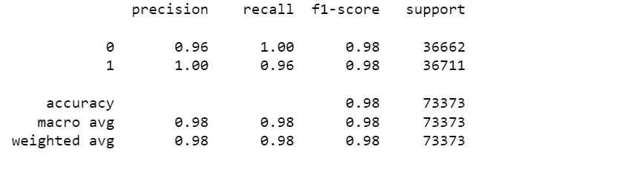
Classification Report:
Model is poor in recalling class 1 i.e., True than class 0 i.e. False, although precision for class 1 is higher than class 0. F1-score of
class 0 is similar to that of class 1.

Slide 32
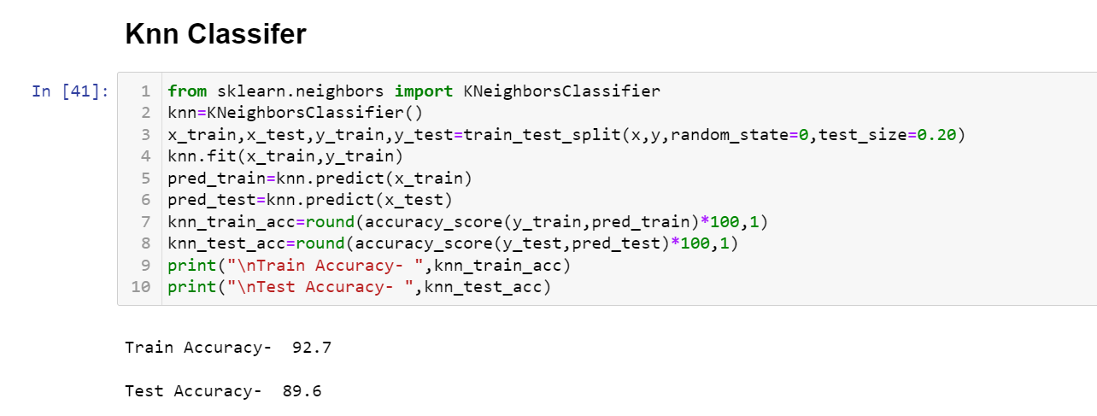
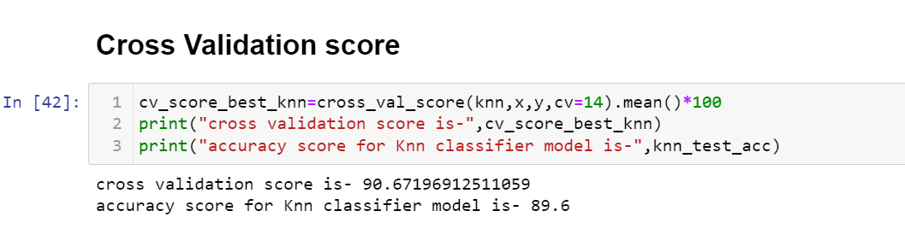
Knn Classifier
We applied this algorithm and found the train accuracy to be 92.7% and test accuracy to be 89.6%.
The test accuracy for logistic regression is 89.6% and its cv score is 90.6% thus making us sure that the model is not overfitted,
although decision tree classifier is prone to overfitting.

Slide 33
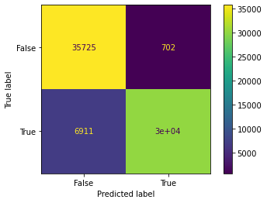
Confusion matrix:
Model is good in predicting false classes but bad in predicting true as well as false classes. Although we can also see that the samples
for true classes and samples for false classes are also equal.

Slide 34
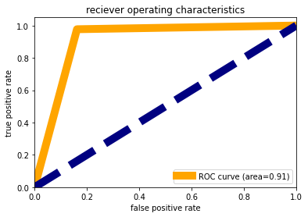
AUC-ROC Curve:
We observed that the area under the curve is 91% that means 91% times model is predicting accurately and rest all
other time it gives wrong prediction. This accuracy is a good one let’s check on other metrics as well.

Slide 35
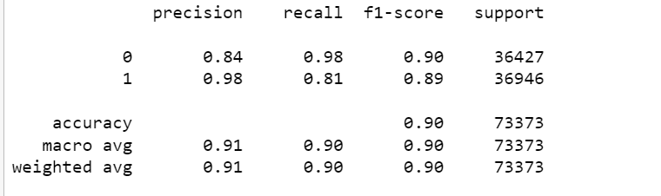
Classification Report:
Model is poor in recalling class 1 i.e., True than class 0 i.e. False, although precision for class 1 is higher than class 0.
F1-score of class 0 is similar to that of class 1.

Slide 36
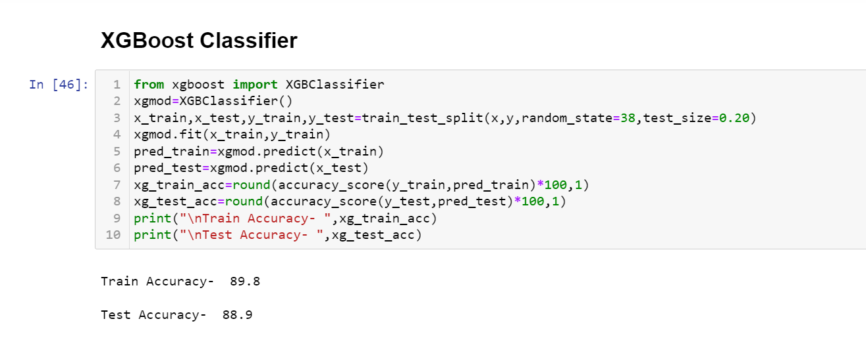
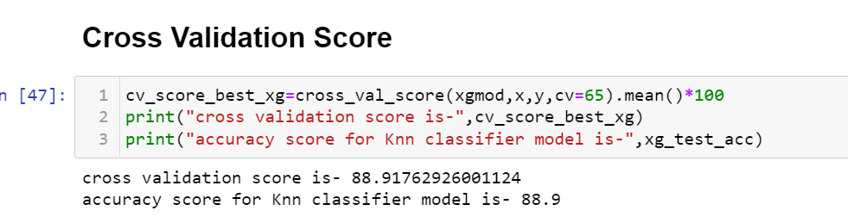
XGBoost Classifier
We applied this algorithm and found the train accuracy to be 89.8% and test accuracy to be 88.9%.
The test accuracy for logistic regression is 88.9% and its cv score is 88.9% thus making us sure that the model is not overfitted,
although decision tree classifier is prone to overfitting.

Slide 37
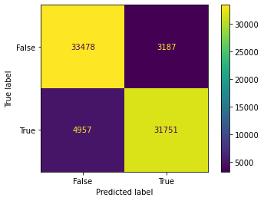
Confusion matrix:
Model is good in predicting false classes but bad in predicting true as well as false classes. Although we can also see
that the samples for true classes and samples for false classes are also equal.

Slide 38
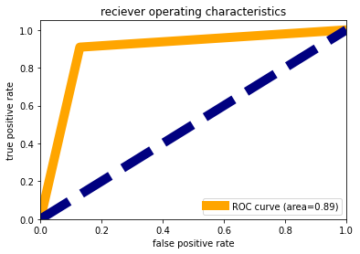
AUC-ROC Curve:
We observed that the area under the curve is 89% that means 89% times model is predicting accurately and rest all
other time it gives wrong prediction. This accuracy is a good one let’s check on other metrics as well.

Slide 39
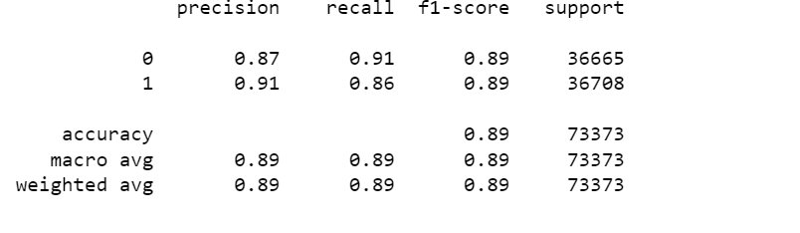
Classification Report:
Model is poor in recalling class 1 i.e., True than class 0 i.e. False, although precision for class 1 is higher than class 0.
F1-score of class 0 is similar to that of class 1.

Slide 40
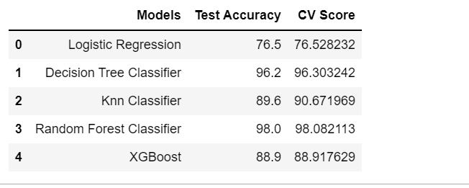
Conclusion for Model
There are three models with least difference between accuracy and cv score but the best performing model is random forest as its confusion matrix, auc-roc curve and recall, f1-score is the best among all. Since the model is already giving its best accuracy so we wont apply hyperparameter tuning as it’s a very big data so we will save our random forest model.

Slide 41
Conclusion

Slide 42
1) Customer paying loan back within 150 days are mostly non-defaulters. 2) Customers taking higher amount of loan and higher frequency of recharge are mostly defaulters. 3) Average main account balance is higher for defaulters than non-defaulters. 4) Average daily amount spend from main account is much higher for defaulters than non-defaulters.

